Slide 1
Artifact Tracking Database
Josh, David, Fletcher, Matt

Slide 2
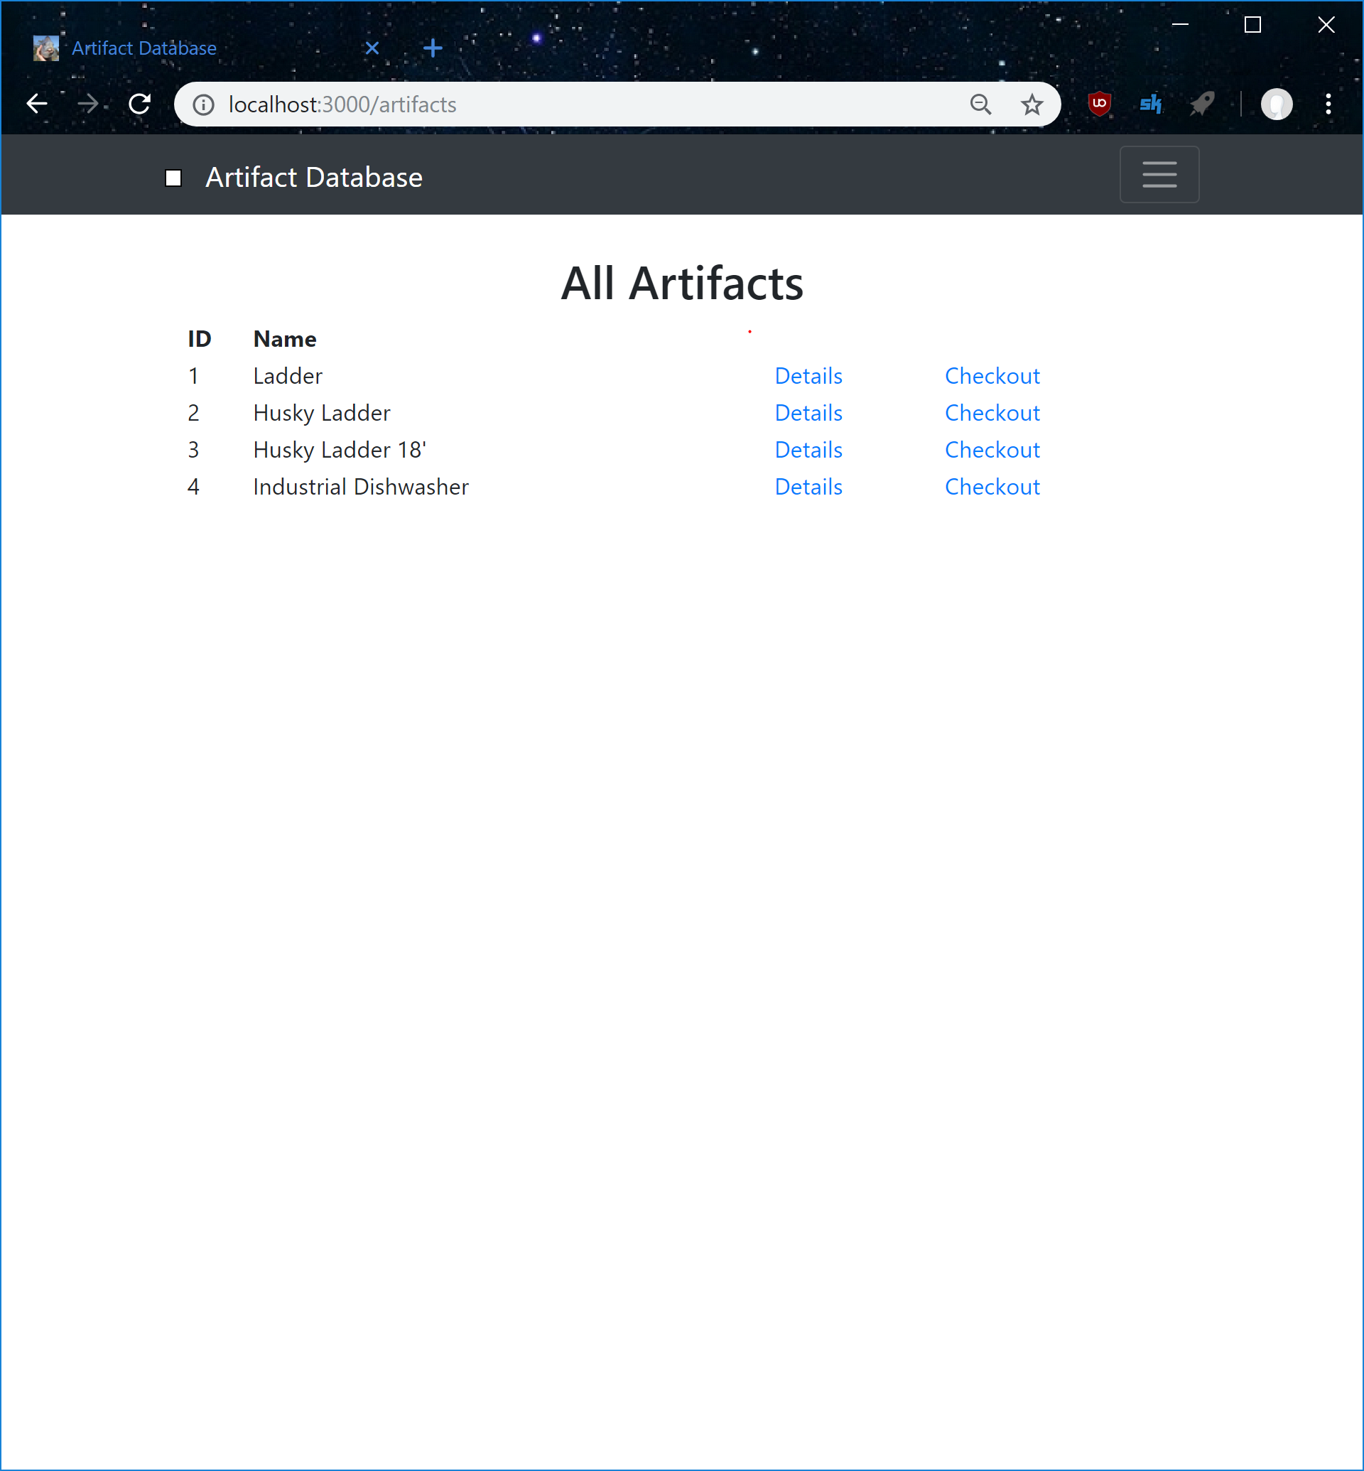
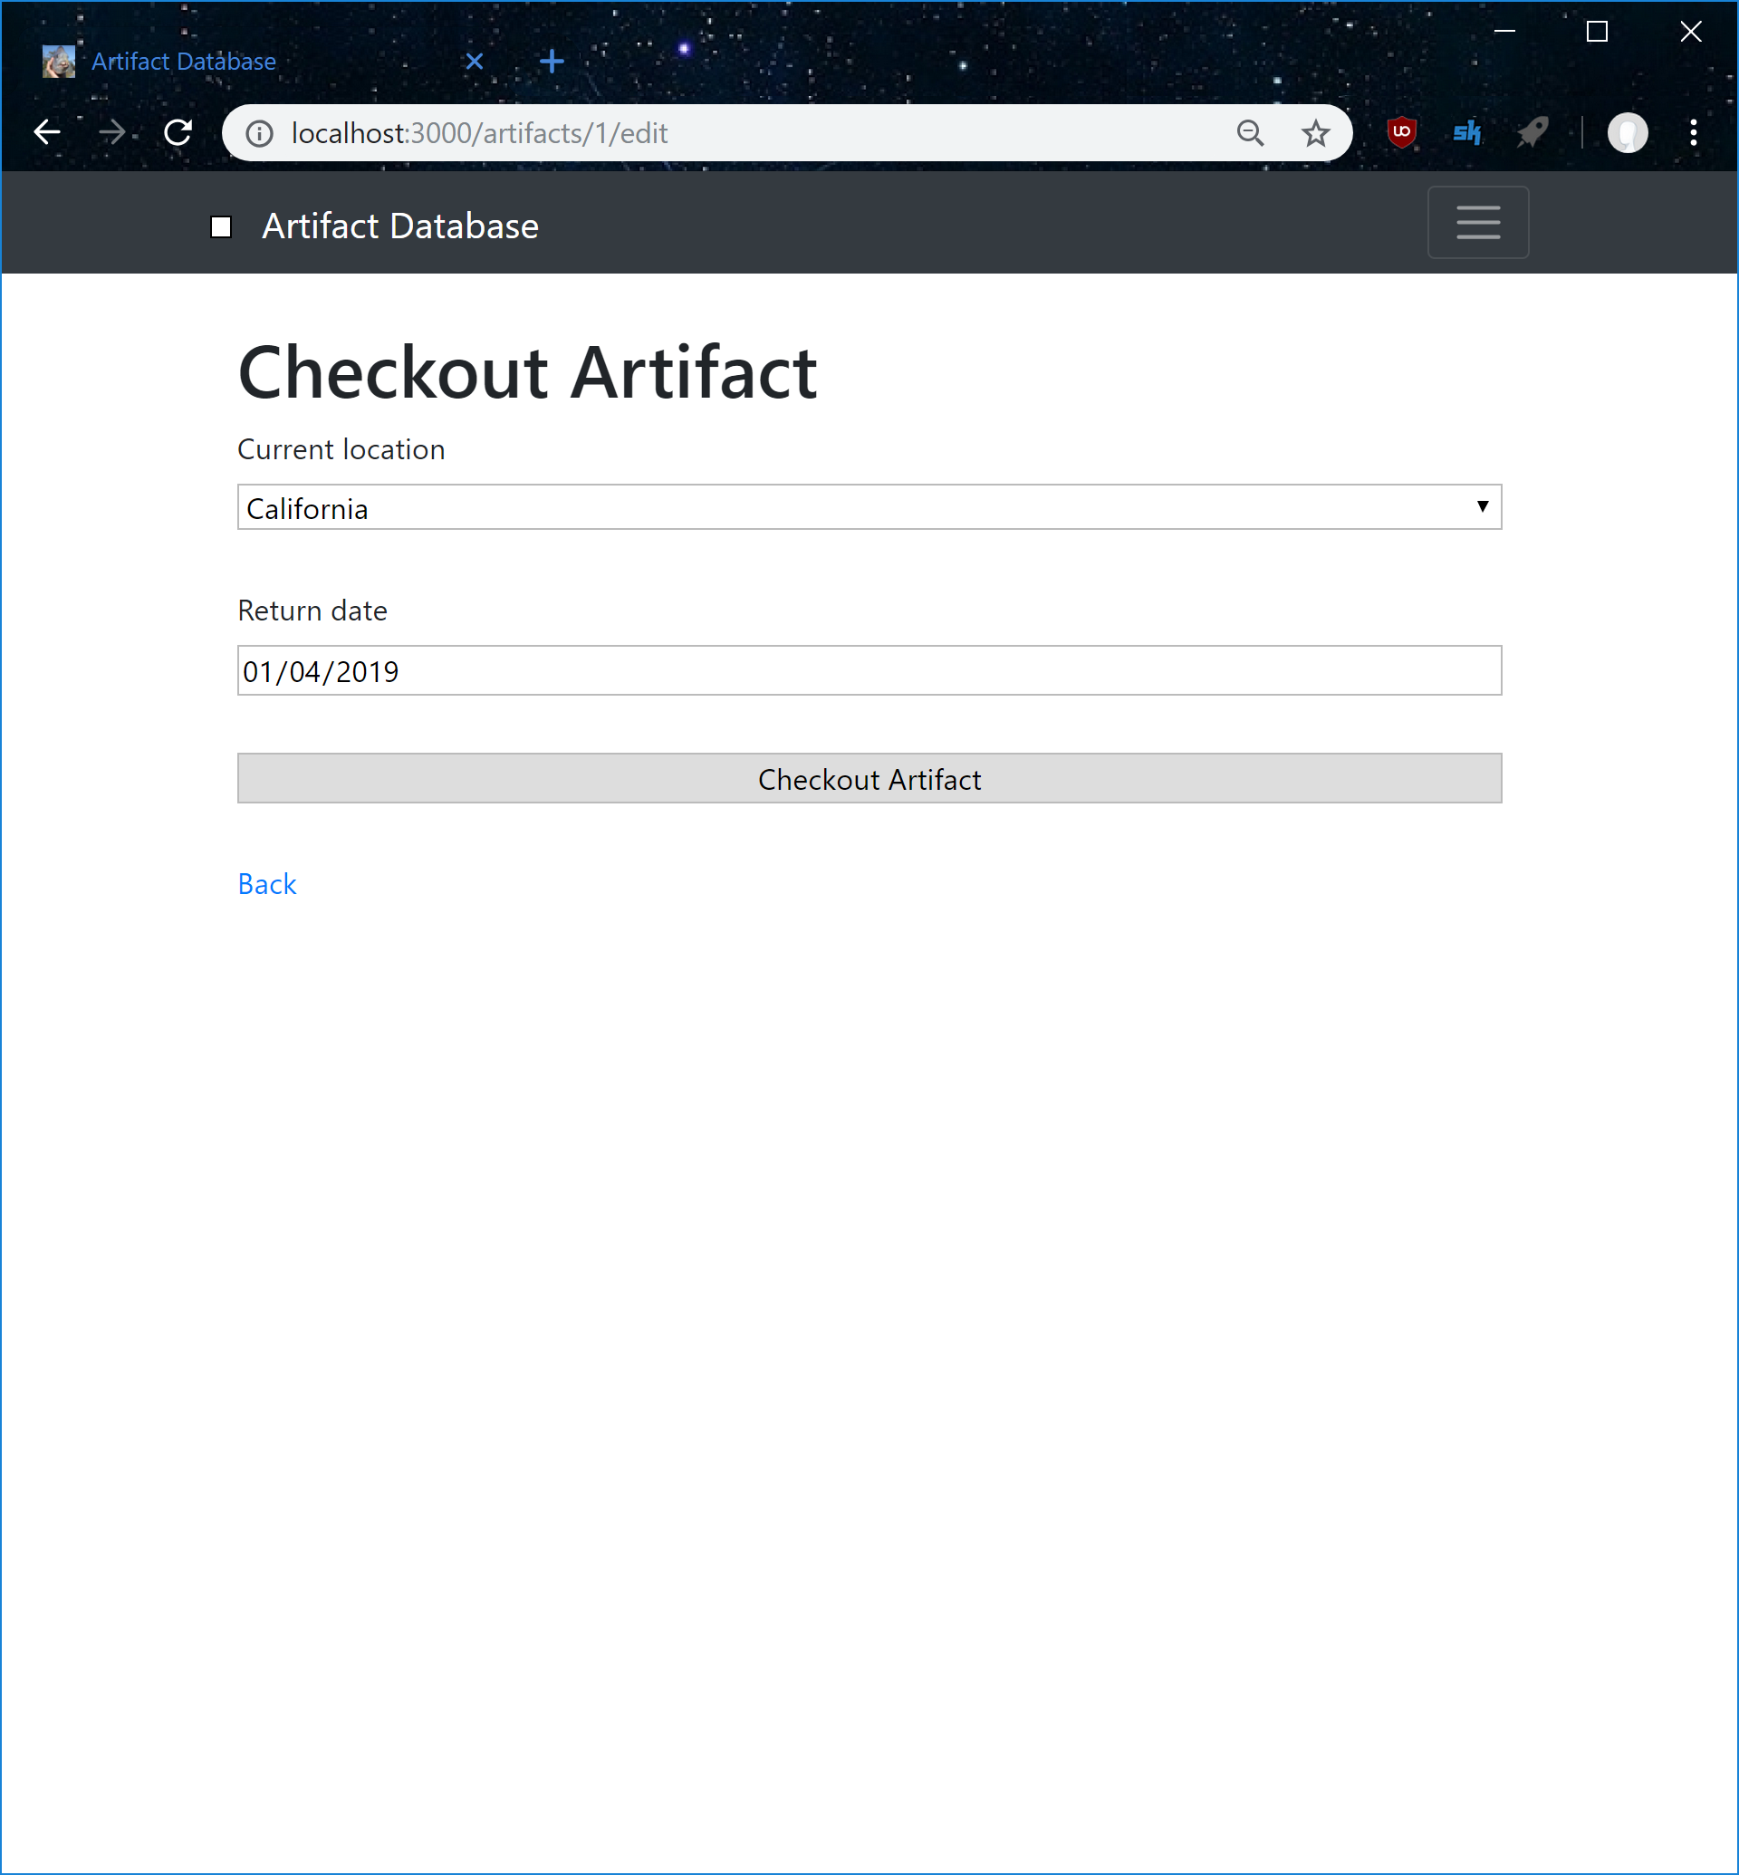
Checkout

Slide 3
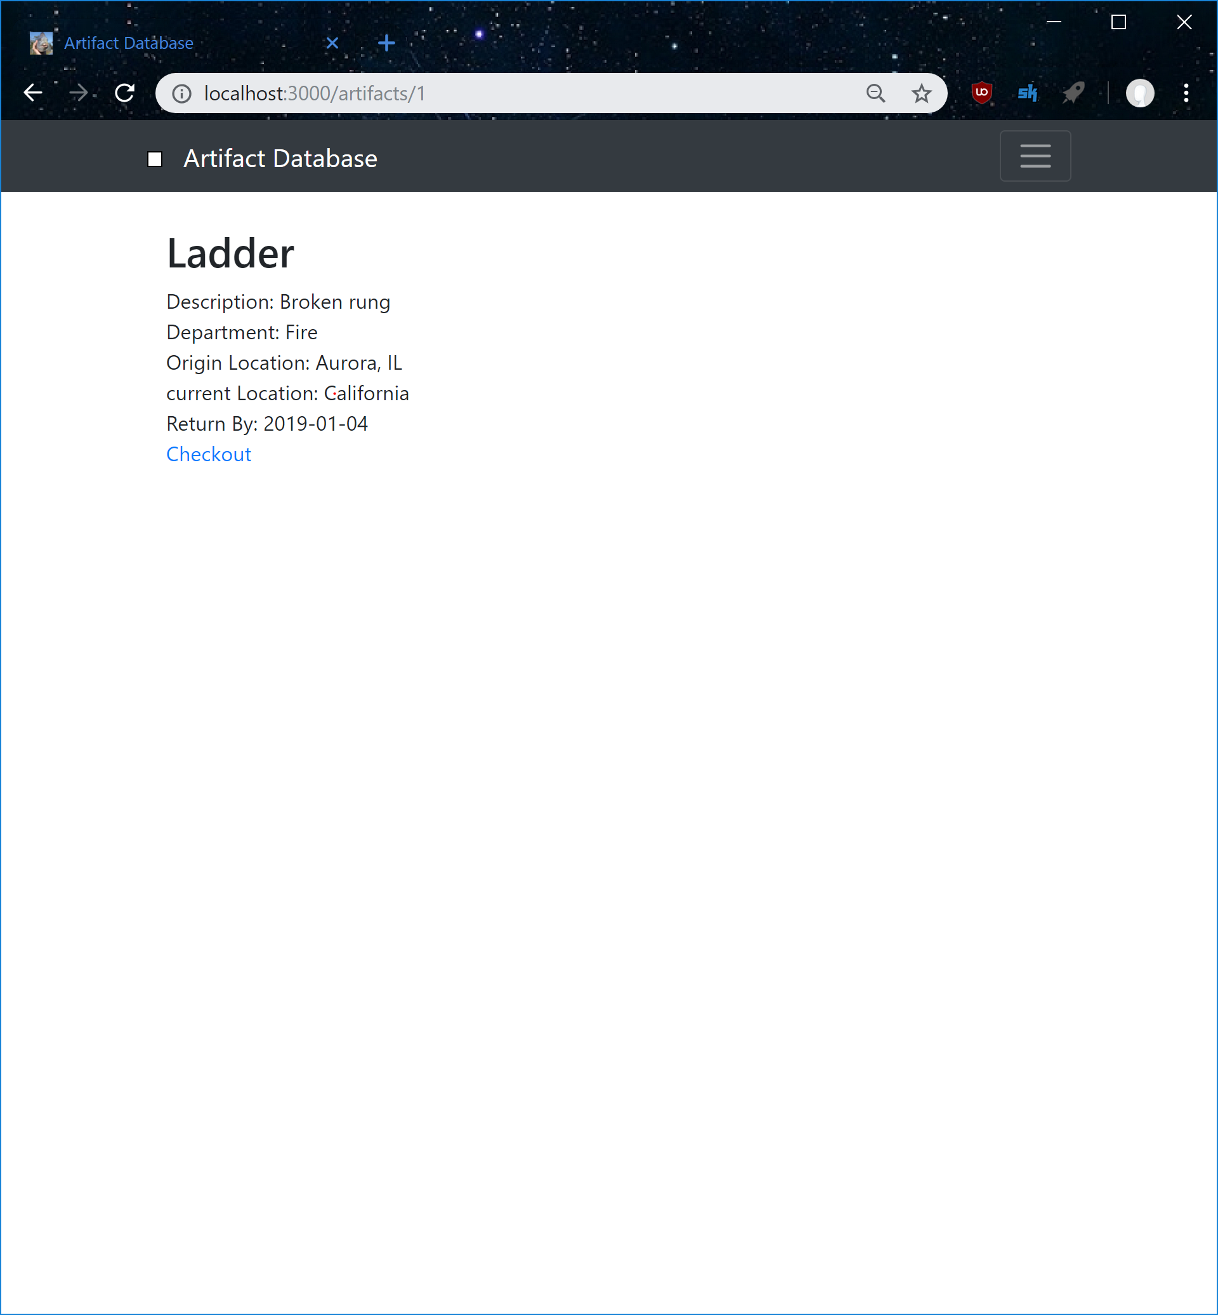
Update Artifact Page

Slide 4
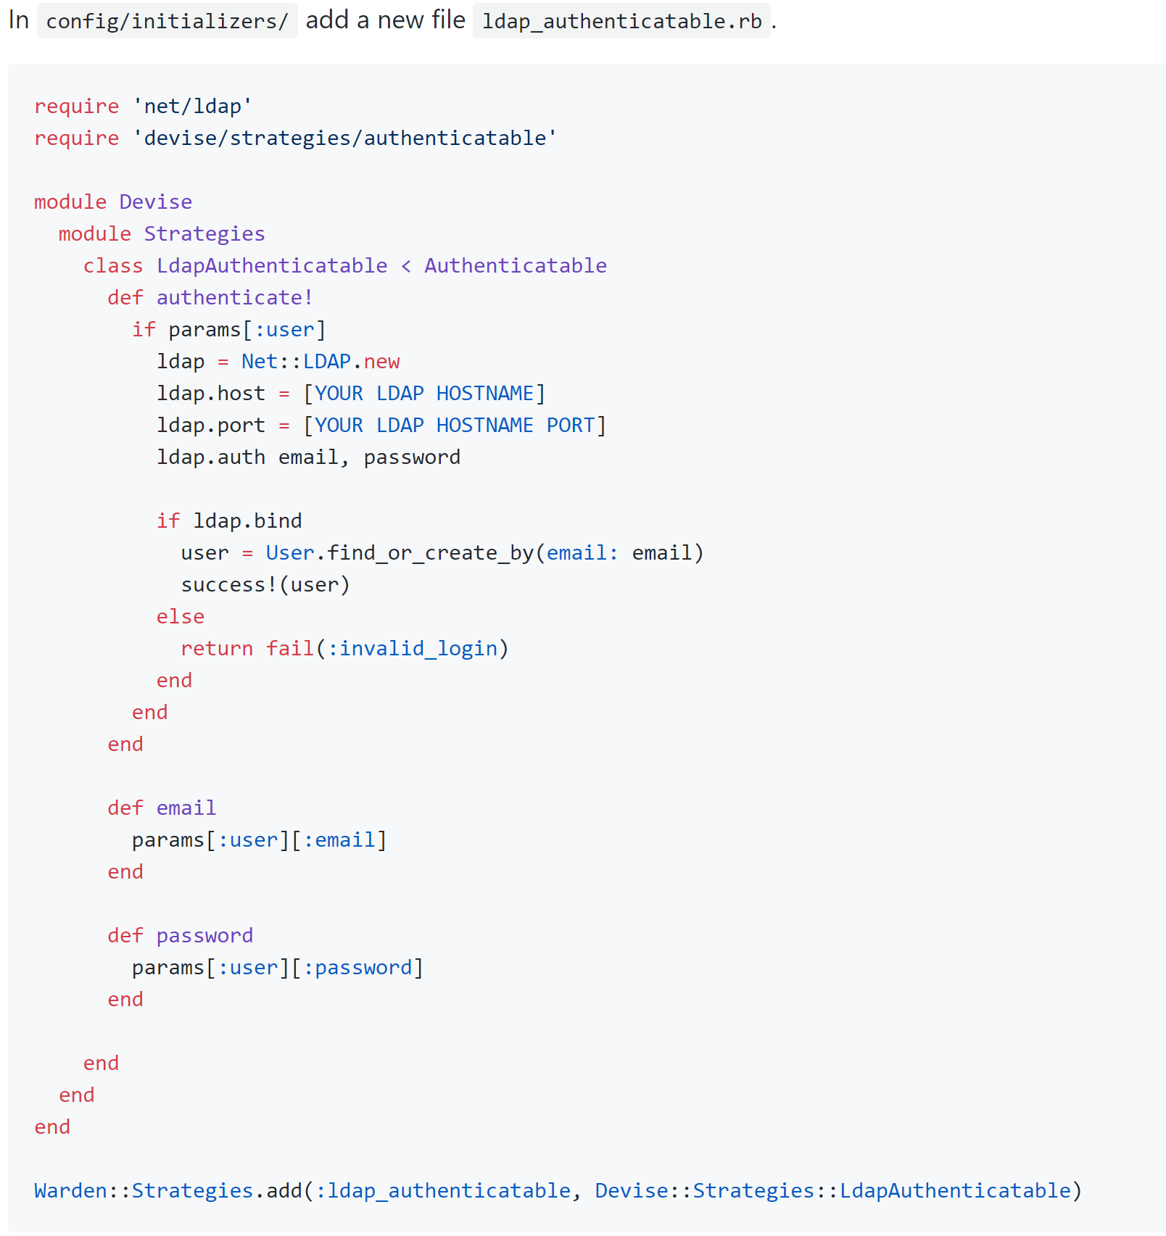
Devise Active Directory
May implement active directory for login
Have to wait for a test environment

Slide 5
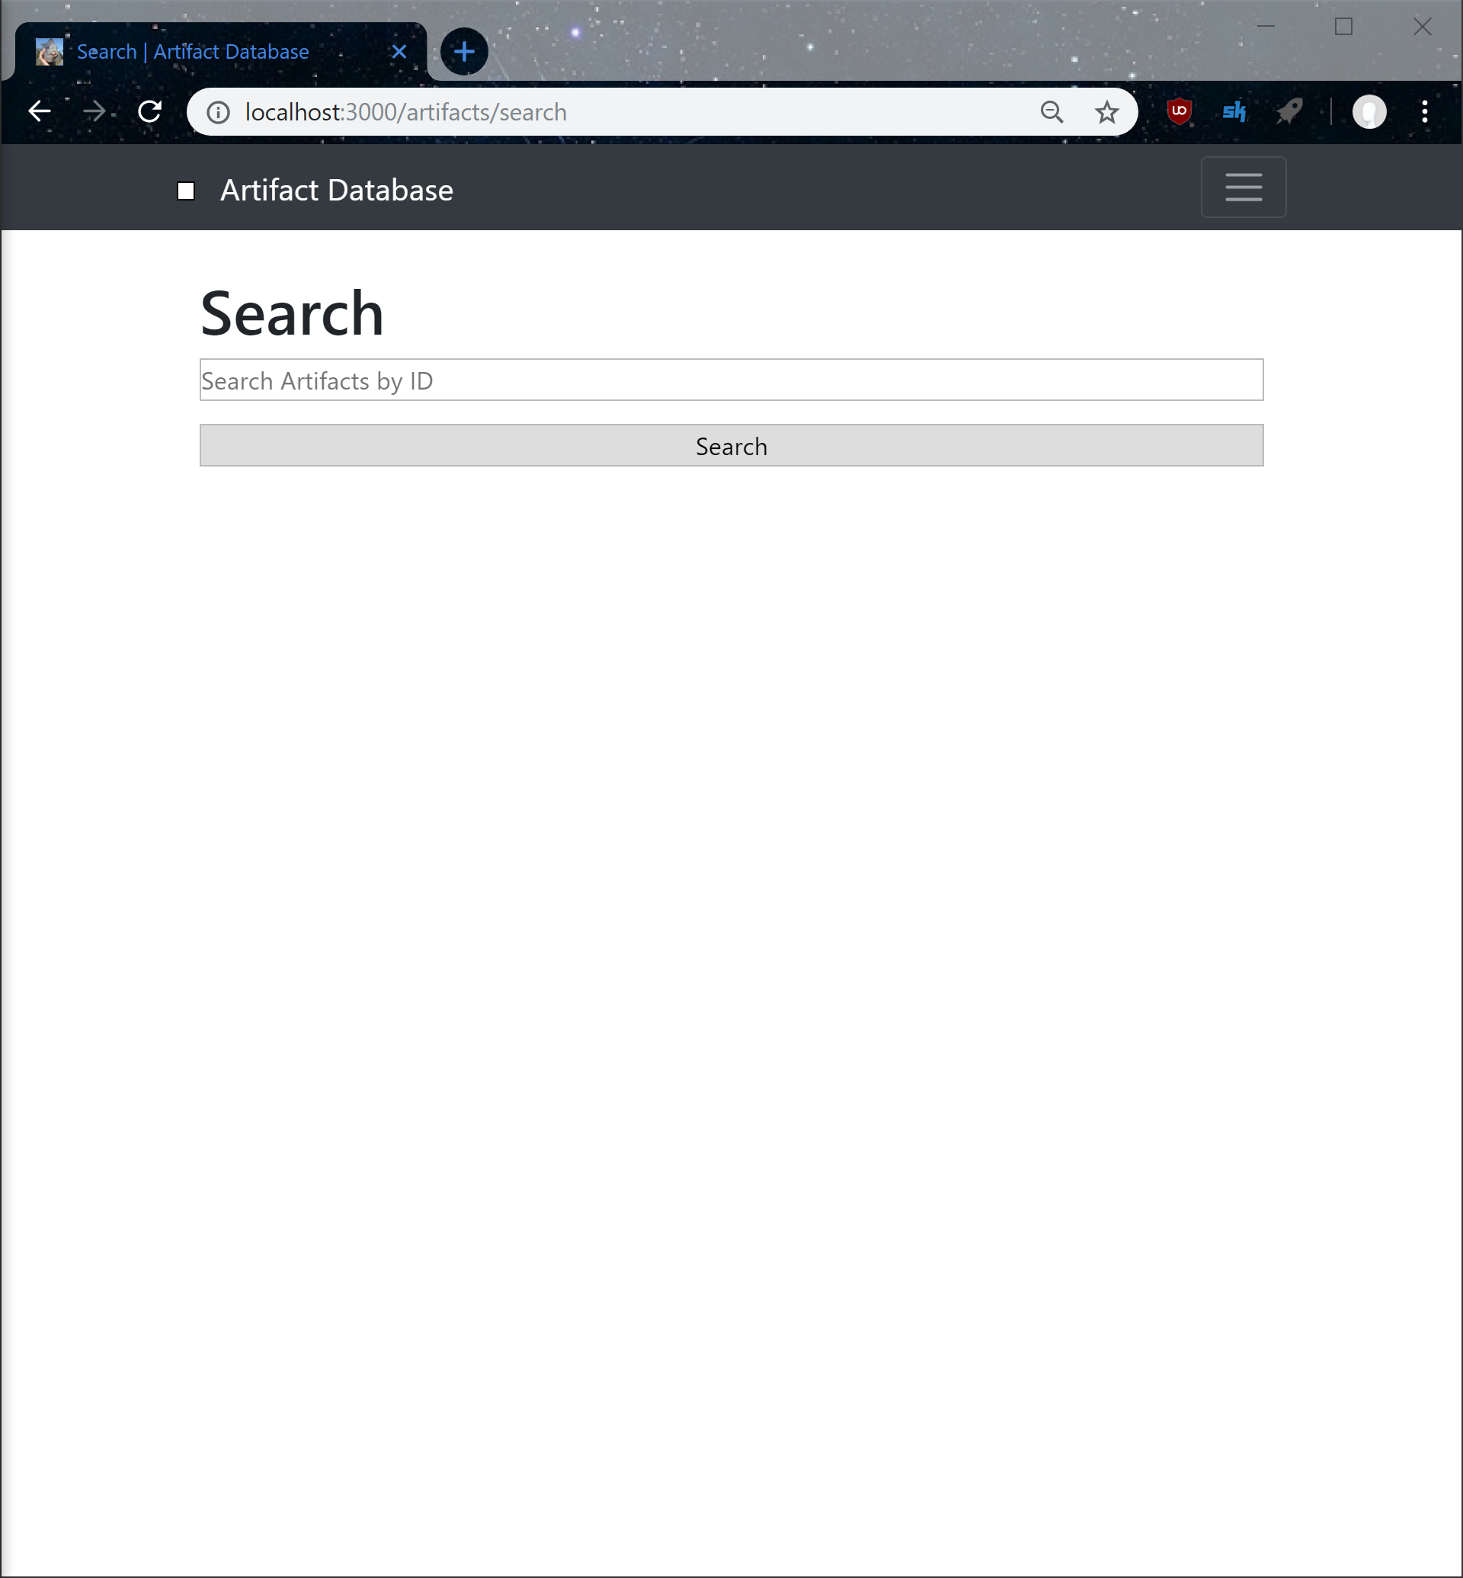
To Do
Implement Search
Get QR Reader to redirect to artifact
Administration Page
Format and optimize site for Mobile platforms
Make the site look good (CSS time)

Slide 6
End

